Slide 1

Project Title – Seasonal Agriculture Performance Analysis
Student Name : Maragani Harshith
College Name : Dhanekula Institute of Engineering and Technology
AICTE STU ID : (STU6803a9ad099dd1745070509 )

Slide 2

PROBLEM STATEMENT
Agricultural activities are influenced by seasonal variations in environmental conditions, farming practices, resource availability and market conditions. As a result, agricultural performance may differ from one season to another.
However, raw agricultural data does not clearly explain how agricultural performance changes across seasons or what patterns can be observed in different seasonal conditions.
The problem is to analyze the given agricultural dataset and investigate seasonal differences in agricultural performance by identifying meaningful patterns, trends, relationships and variations within the available data.

Slide 3
Project Description
The project analyzes seasonal agricultural data to understand variations in crop performance.
It examines yield, production, profit, water usage, rainfall, and disease/pest risk.
Data cleaning and statistical analysis are performed to ensure reliable results.
Visualizations are used to identify seasonal patterns and relationships.
The project provides evidence-based insights and recommendations for better agricultural planning

Slide 4

WHO ARE THE END USERS?
Farmers can use the analysis to understand seasonal crop performance.
Agricultural managers can compare yield, profit, and resource efficiency.
Researchers can study relationships between environmental conditions and agricultural outcomes.
Agricultural organizations can use the insights for planning and resource allocation.
Overall, the project supports data-driven agricultural decision-making.

Slide 5

Technology Used
  The project is developed using Python in Google Colab environment.
  Pandas and NumPy are used for data processing and analysis.
  Matplotlib is used to create charts and visualizations.
  SciPy is used for statistical analysis and testing.
  The project generates analytical tables, visualizations, and recommendation outputs.

Slide 6
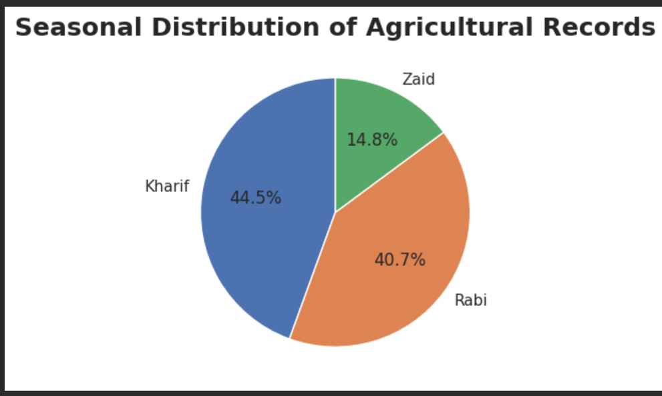
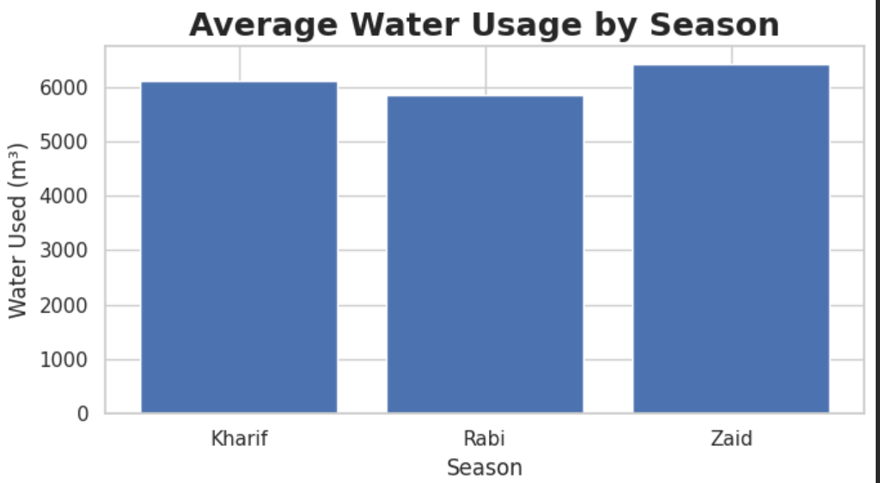
RESULTS

Slide 7
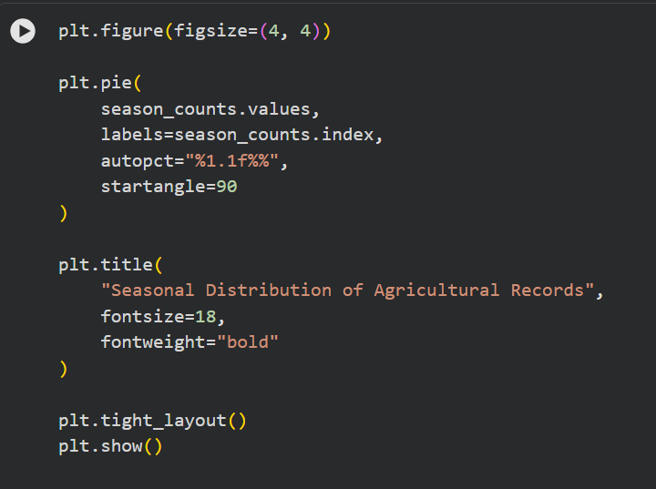
RESULTS
Seasonal distribution of agriculture records and irrigation analysis

Slide 8
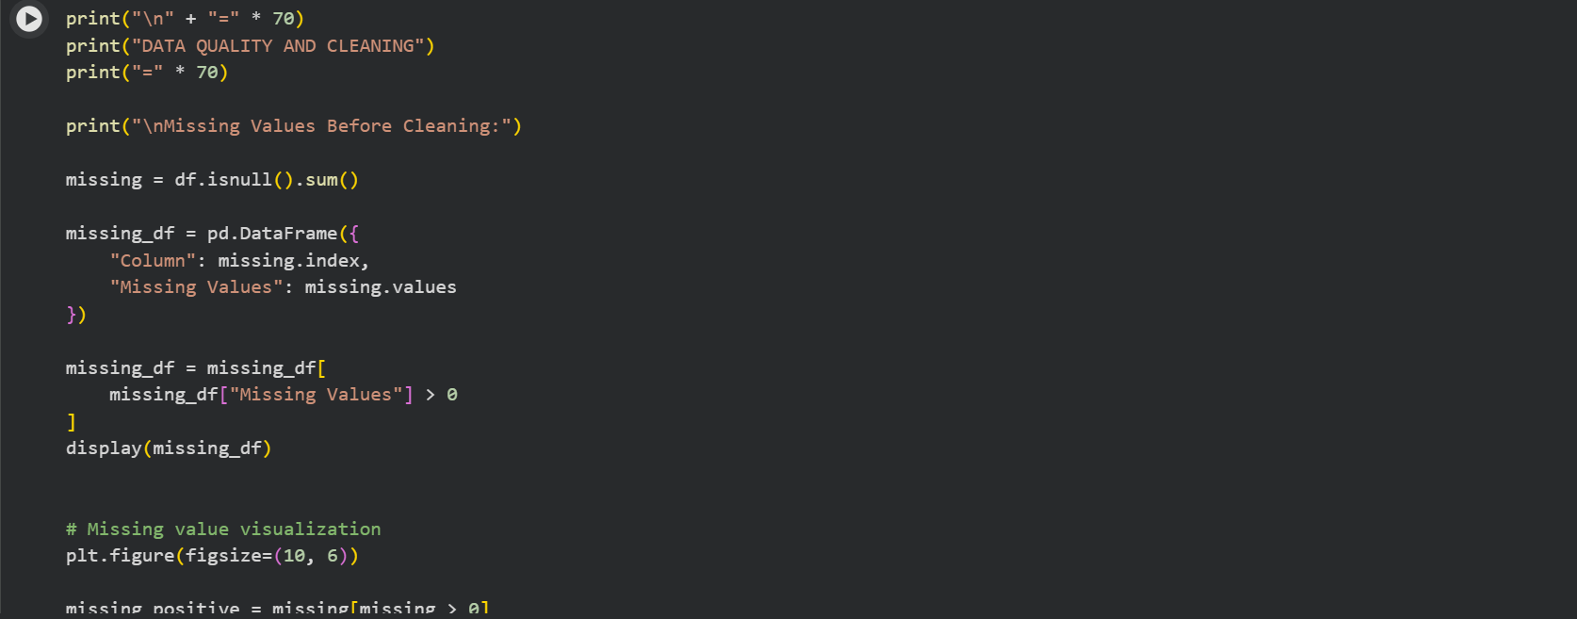
RESULTS

Slide 9
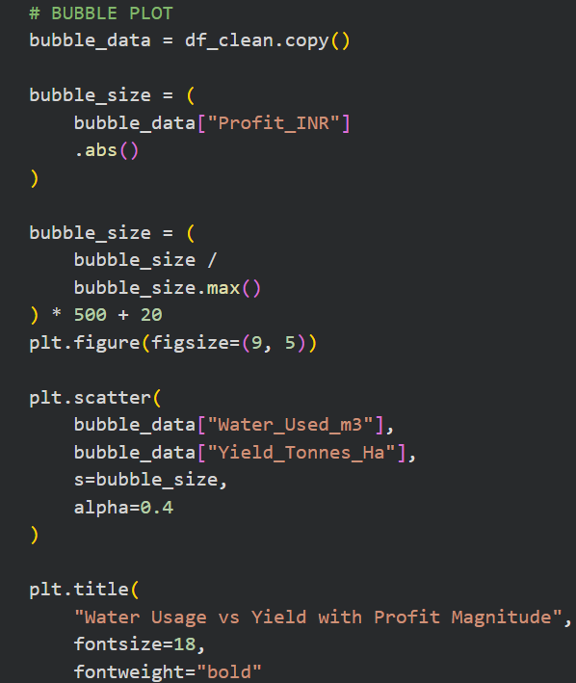
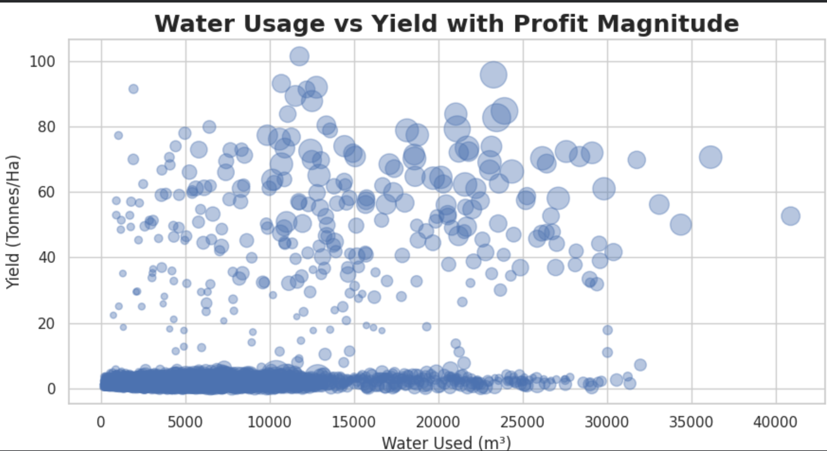
RESULTS
WATER USAGE VS YIELD WITH PROFIT MAGNITUDE

Slide 10
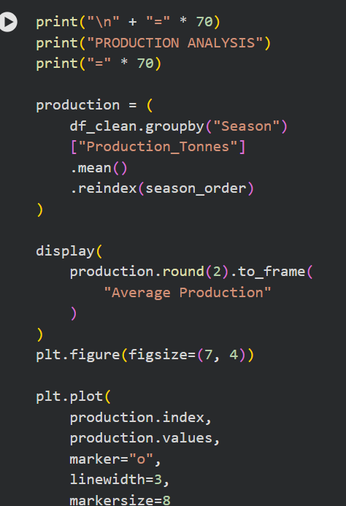
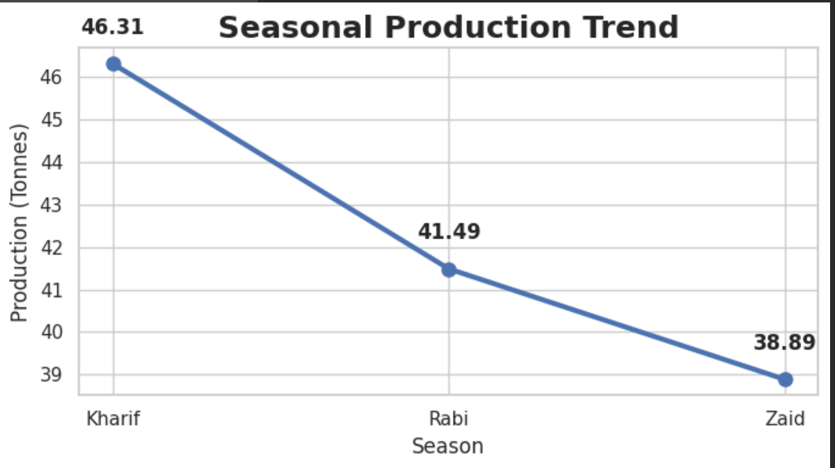
RESULTS
SEASONAL PRODUCTION TREND

Slide 11
Future scope
The project can be extended by using real-time weather and agricultural data.
Machine learning can be added to predict crop yield and profitability.
Additional soil, fertilizer, temperature, and market-price data can improve the analysis.
The system can eventually become a decision-support tool for precision agriculture.

Slide 12
GitHub Link
https://github.com/Harshith-4269/Seasonal-Agriculture-Performance-Analysis.git

Slide 13

VOIS Course completion certificate -
Course name- Data Visualization

Slide 14
Thank you
.
.

